Slide 1
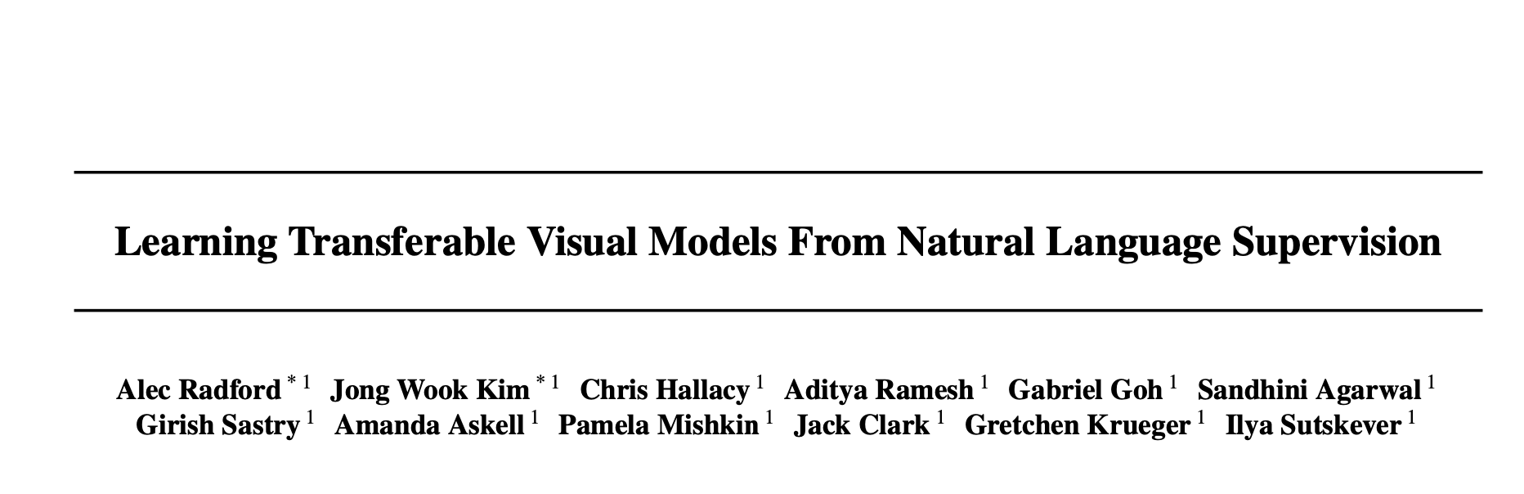
Lecture 3
Image/Language Cross Training

Slide 2
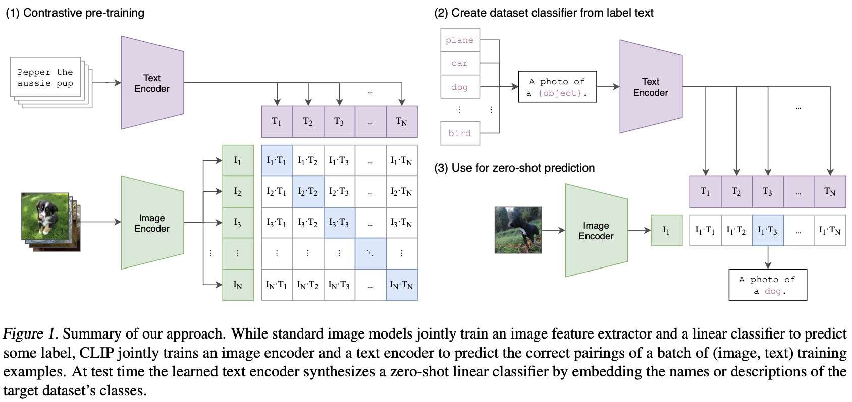

Slide 3
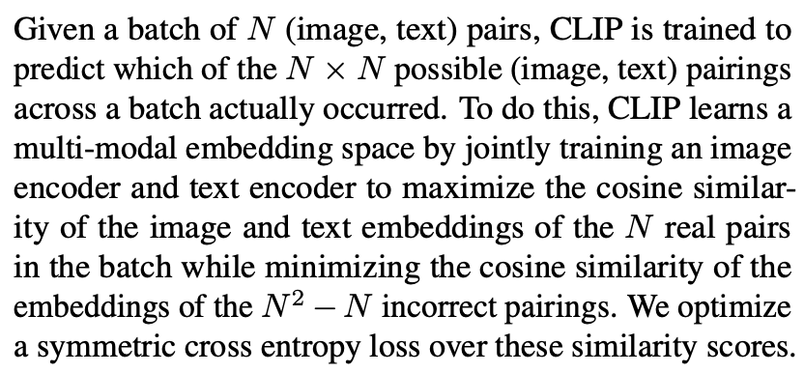

Slide 4
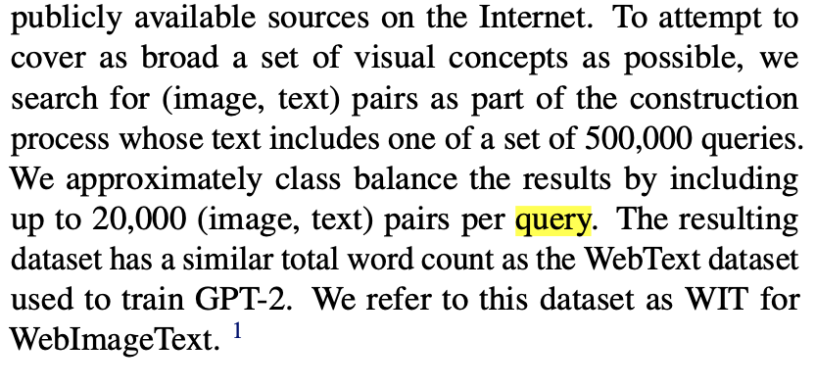
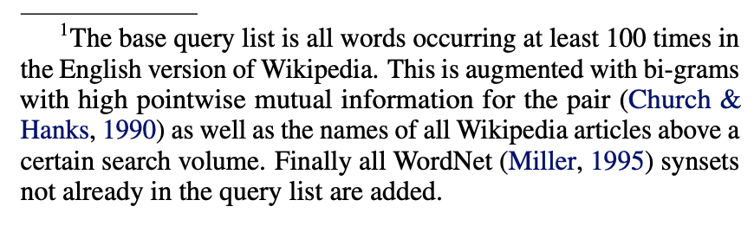

Slide 5
ML Background Questions:
“What is the SOTA algorithm?”
”What is one-shot learning?”
“What is few-shot learning?”
“What is zero-shot learning?”

Slide 7
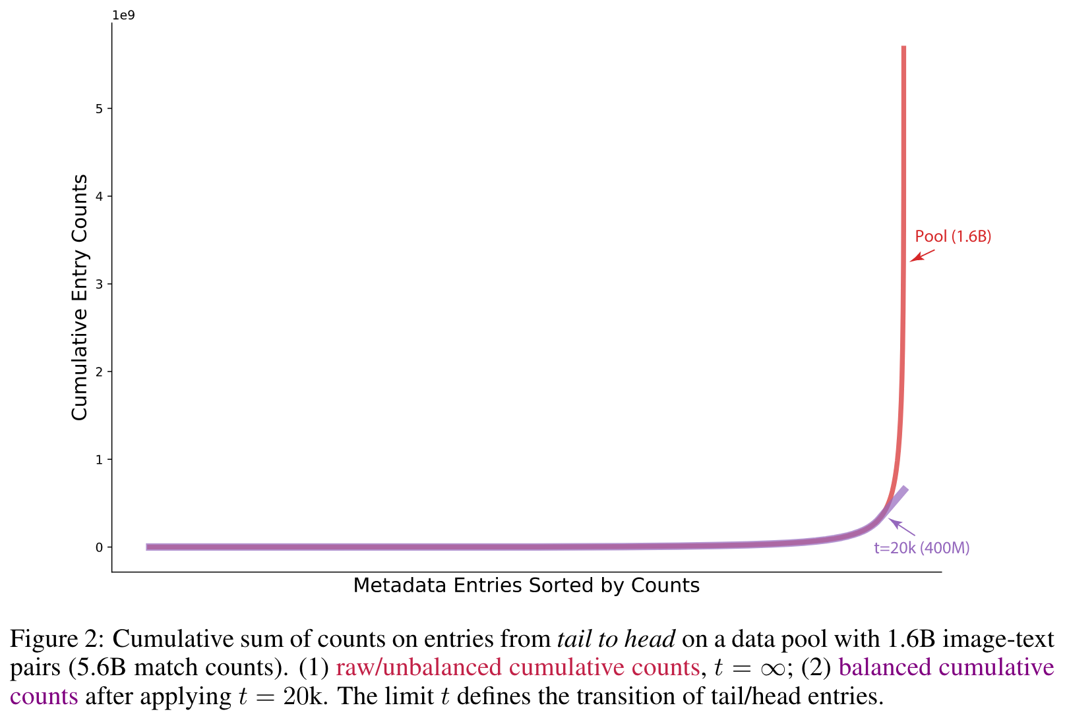
Technical ML Background Questions:
"What is class balancing and why is there a need to class balance the results by including up to 20,000 (image, text) pairs per query?"
QUERY AND BALANCING WITH t ≤20K
CLIP searches for 500,000 terms. For each term, if there are more than 20K image-text pairs then the dataset samples 20K of those pairs. Terms with fewer pairs retain all associated pairs, while entries with more pairs are sub-sampled to 20k pairs. The value of t = 20k seemingly represents the transition from normal to “viral”, or “special case” queries, and reduces dominance and noise common web terms. E.g., out of 400M pairs, only 20k texts containing “photo” are kept (while there are 54M “photo” instances in the pool).
This leads to more task-agnostic classifers.
Text inspired by and plot exactly from: https://zhangtemplar.github.io/clip-data/

Slide 8
”Hands on CLIP”
https://laion.ai/blog/laion-coco/ (broken, 2023!)
https://huggingface.co/spaces/vivien/clip (broken 2025!)
My favorite: https://josephrocca.github.io/clip-image-sorter/

Slide 9
Scaling and Compute Constraints
The largest model (RN50x64) took 18 days on 592 V100 GPUs. The authors estimate needing 1000x more compute to reach overall SOTA. Is this scaling approach sustainable, or should we focus on algorithmic improvements instead?

Slide 10
Zero-Shot vs Supervised / Linear Probing
With CLIP do we sacrifice specificity for better generalization accuracy? How should we interpret the comparison between zero-shot CLIP and CLIP with a linear probe? And why do we compare with CLIP with linear probing?

Slide 11
Strengths vs Weaknesses Across Tasks
In CLIP's experimental results, the model significantly outperforms traditional methods on some fine-grained classification tasks (such as Stanford Cars and Food101), but performs poorly on Flowers102 and FGVCAircraft. What are the main reasons for this discrepancy? What strategies can be adopted to improve CLIP's performance on these "weak" tasks?

Slide 12
Noisy Web Data and Bias
Since CLIP learns from internet image - text pairs, how can we make sure the model doesn’t just pick up the same biases and mistakes people make online?

Slide 13
Contrastive Learning Objective
The paper shows that their contrastive approach is 4x more efficient than bag-of-words prediction and more efficient than transformer language modeling (Figure 2). What makes the contrastive objective so much more sample-efficient for this task?

Slide 14
Representation Limits & Semantics
How does the model handle logical negation (e.g: "a photo of a car that is not red"), sarcasm, or complex compositional phrases in zero-shot prompts?

Slide 15
Prompt Engineering / Sensitivity
Zero-shot accuracy in CLIP is sensitive to wording of prompts (e.g., "an image of…" vs. "a photo of…"). How sensitive is the model to this wording, and is there a systematic method for determining or creating optimal prompts?

Slide 16
Architecture Choices (ResNet vs ViT, Linear projections, etc.)
Why did the authors use both ResNets and Transformers as image encoders — what strengths does each bring?

Slide 17
Dataset Design and Benchmarks (ImageNet, ImageNot, LAION)
What general point about benchmarks and generalization are the authors trying to make by creating ImageNot?
What is ImageNot?
A new image classification dataset derived from LAION-5B (a massive publicly available image-text dataset).
It has 1,000 classes chosen from WordNet, specifically excluding classes close to or overlapping with ImageNet classes. The aim is to get a comparable scale but different content.
For each class, they pick ~1,000 images from LAION-5B. Selection is based on caption-class similarity using Roberta text embeddings. Importantly, Roberta wasn’t trained on ImageNet, which helps avoid bias toward ImageNet-like images.

Slide 19
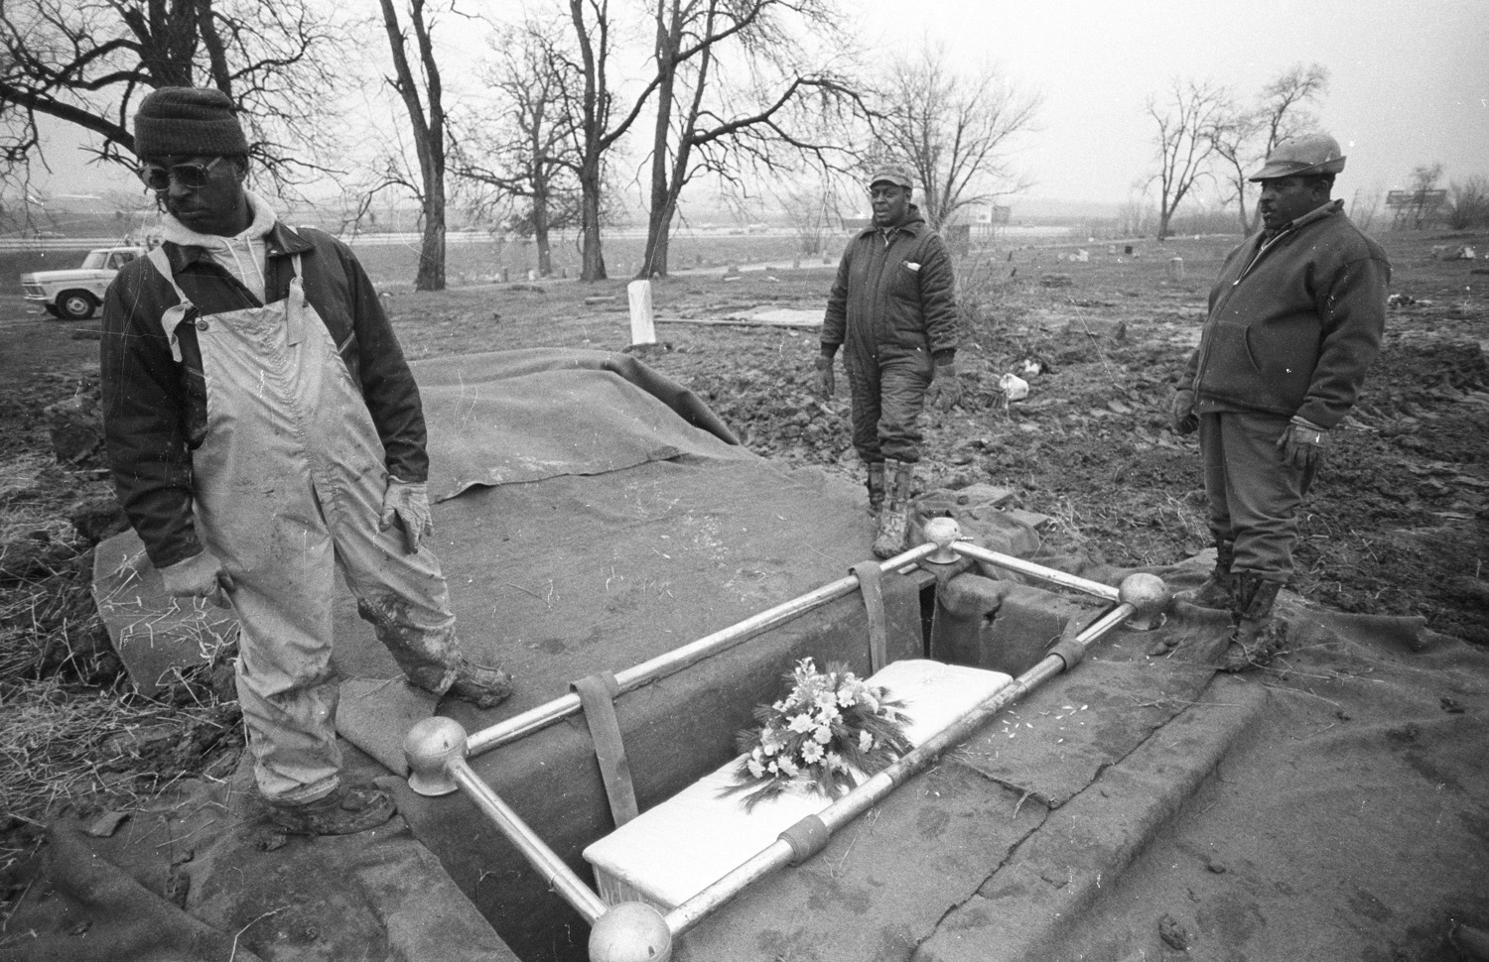
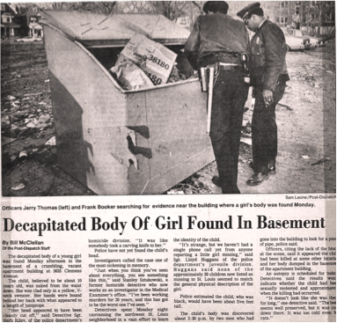
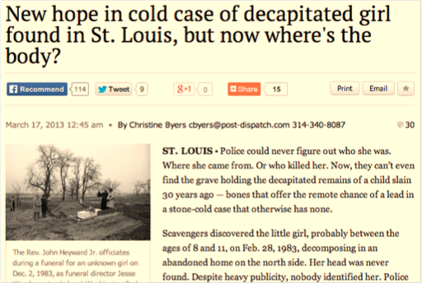

Slide 20
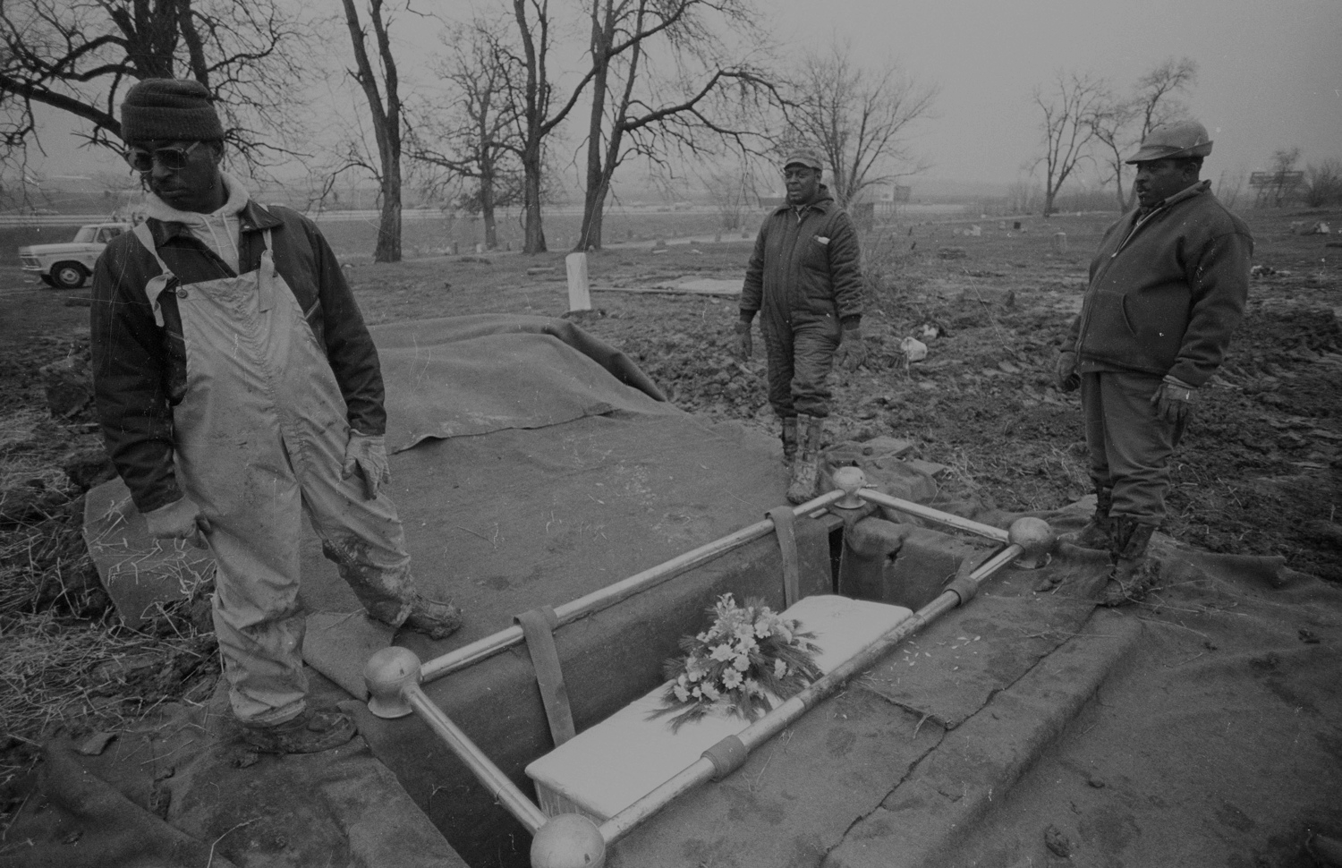

Slide 21
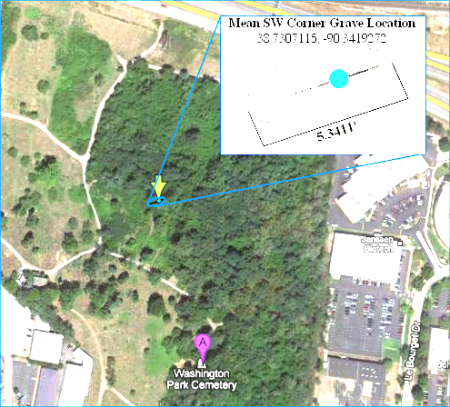
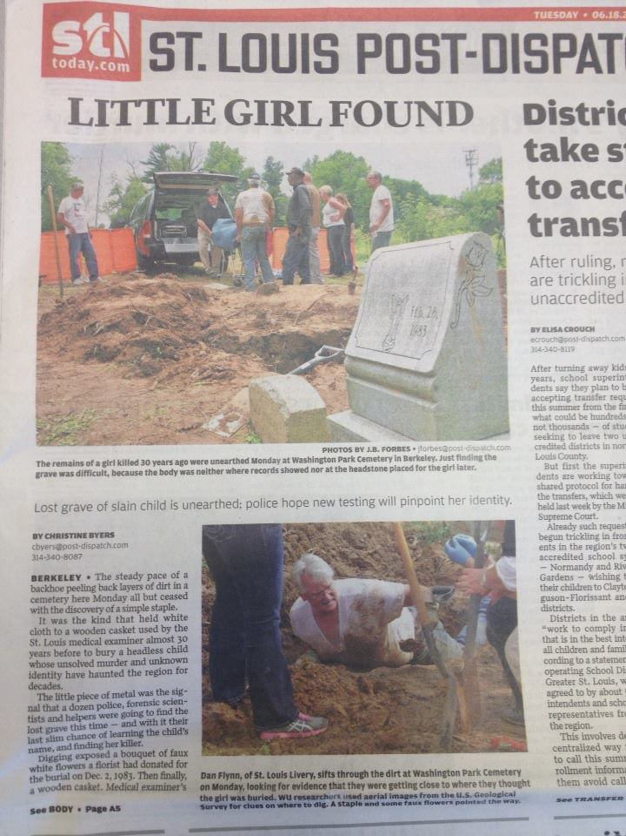
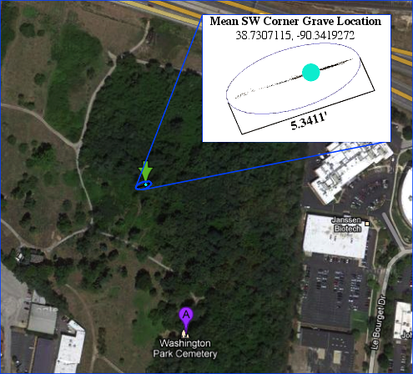
Notes:
SAVE ABBY story about digging deeper for next slide

Slide 22
Story
Finding the Lost Grave of Jane Doe
Work w/ PhD student Abby Stylianou.
Partially funded through I/ARPA grant with Object Video, U. Kentucky, I. Indiana
Best paper at the International Conference on Imaging in Crime Detection and Prevention, 2013
Warning, this is a morbid story

Slide 23
1983

Slide 24
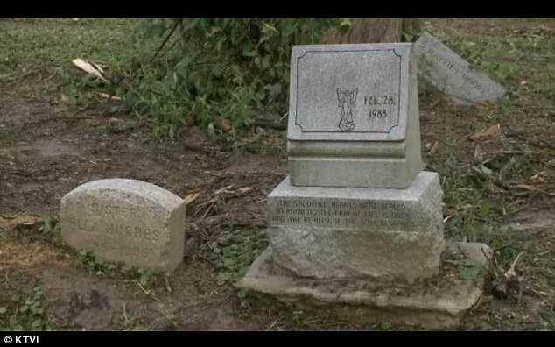
1984
Notes:
College student donated money for headstone.

Slide 25
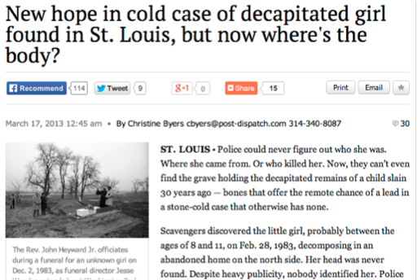
2013

Slide 26

From the burial

Slide 27
Step 1: Find key points in the image that might still be present.

Slide 28
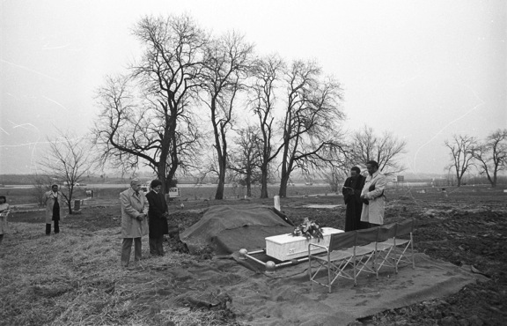
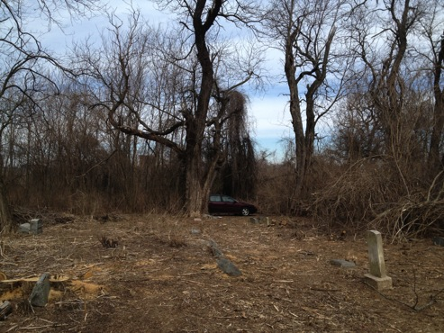
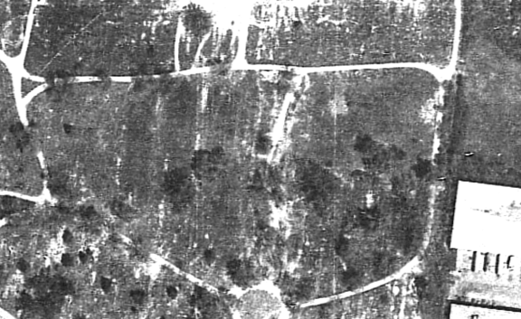
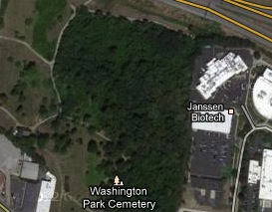
Step 2: Match points in the image to geolocated points
in the real world.
CHALLENGE #1: The cemetery is largely forested today.
1983
2013

Slide 29
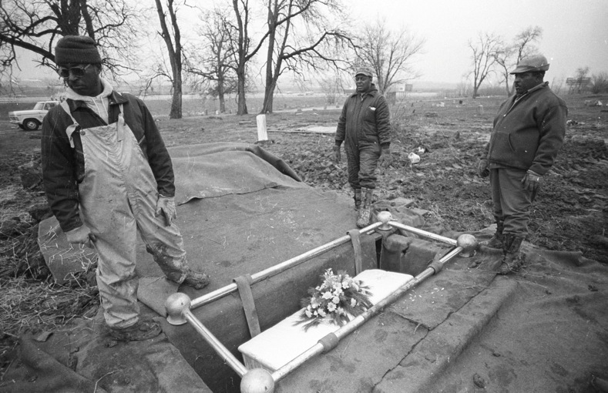
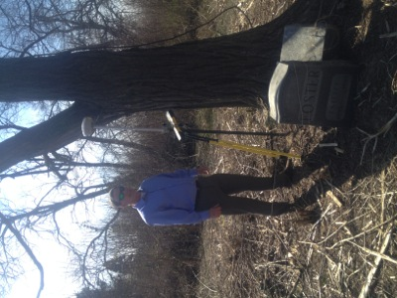
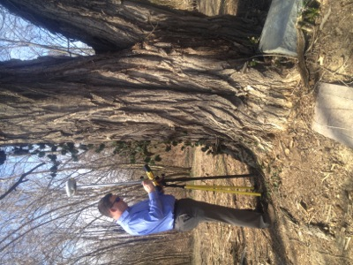
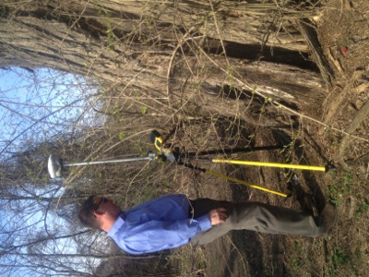
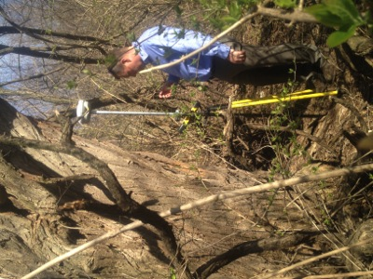
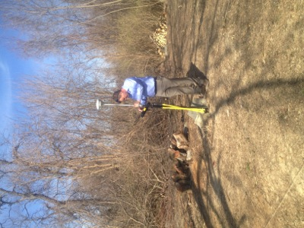
Step 2: Match points in the image to geolocated points
in the real world.

Slide 30

Step 2: Match points in the image to geolocated points
in the real world.
CHALLENGE #2: Some important objects aren’t there today.
This billboard was rebuilt in the 1990s,
about 10 feet from its 1983 location.

Slide 31

Step 2: Match points in the image to geolocated points
in the real world.
CHALLENGE #2: Some important objects aren’t there today.
Only one of these two trees is still standing.
It had to be identified using 1980s aerial imagery.

Slide 32
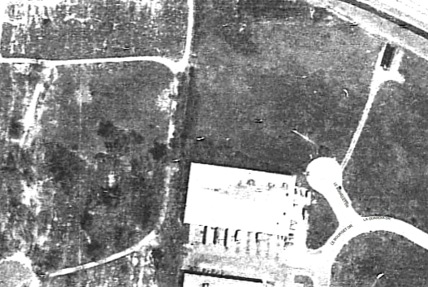
Step 2: Match points in the image to geolocated points
in the real world.
CHALLENGE #2: Some important objects aren’t there today.
There are buildings today where this billboard was located.
It was only visible in 1980s aerial imagery.

Slide 33
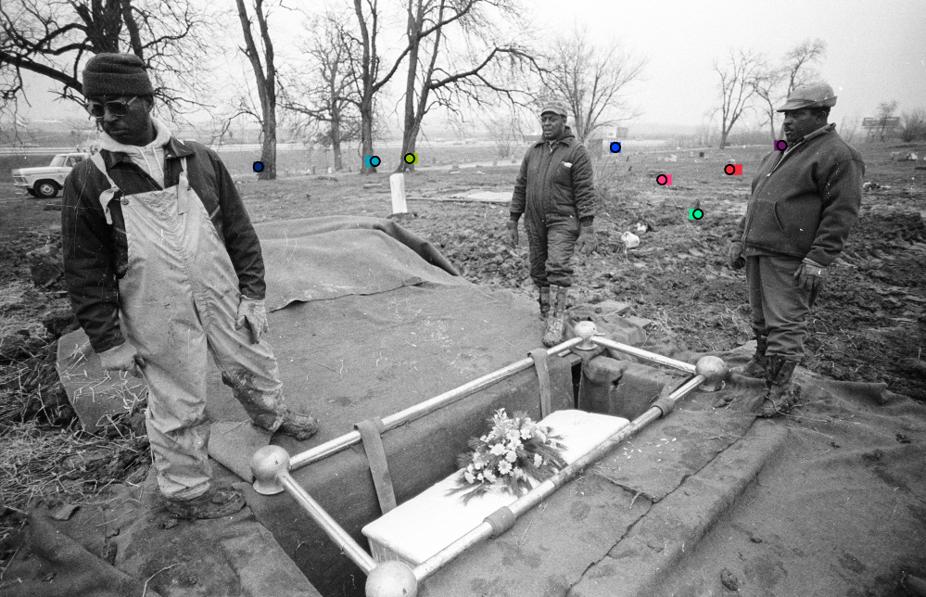
Step 3: Solve for the geometric constraints that provide
the optimal camera location.
Circles outlined in black are the location of a correspondence in the image.
Matching colored squares are where these points would be projected into this image given their GPS coordinates, a camera location and focal length.
Given the optimal camera location and focal length, these would be perfectly aligned.

Slide 34

CHALLENGE #3: Even the super precise GPS device has some measurement error. Our model had to account for that.
Notes:
This region of possible locations was generated by running the geometric optimization 1000 times, allowing the error associated with each point to vary slightly in magnitude and direction each time.

Slide 35
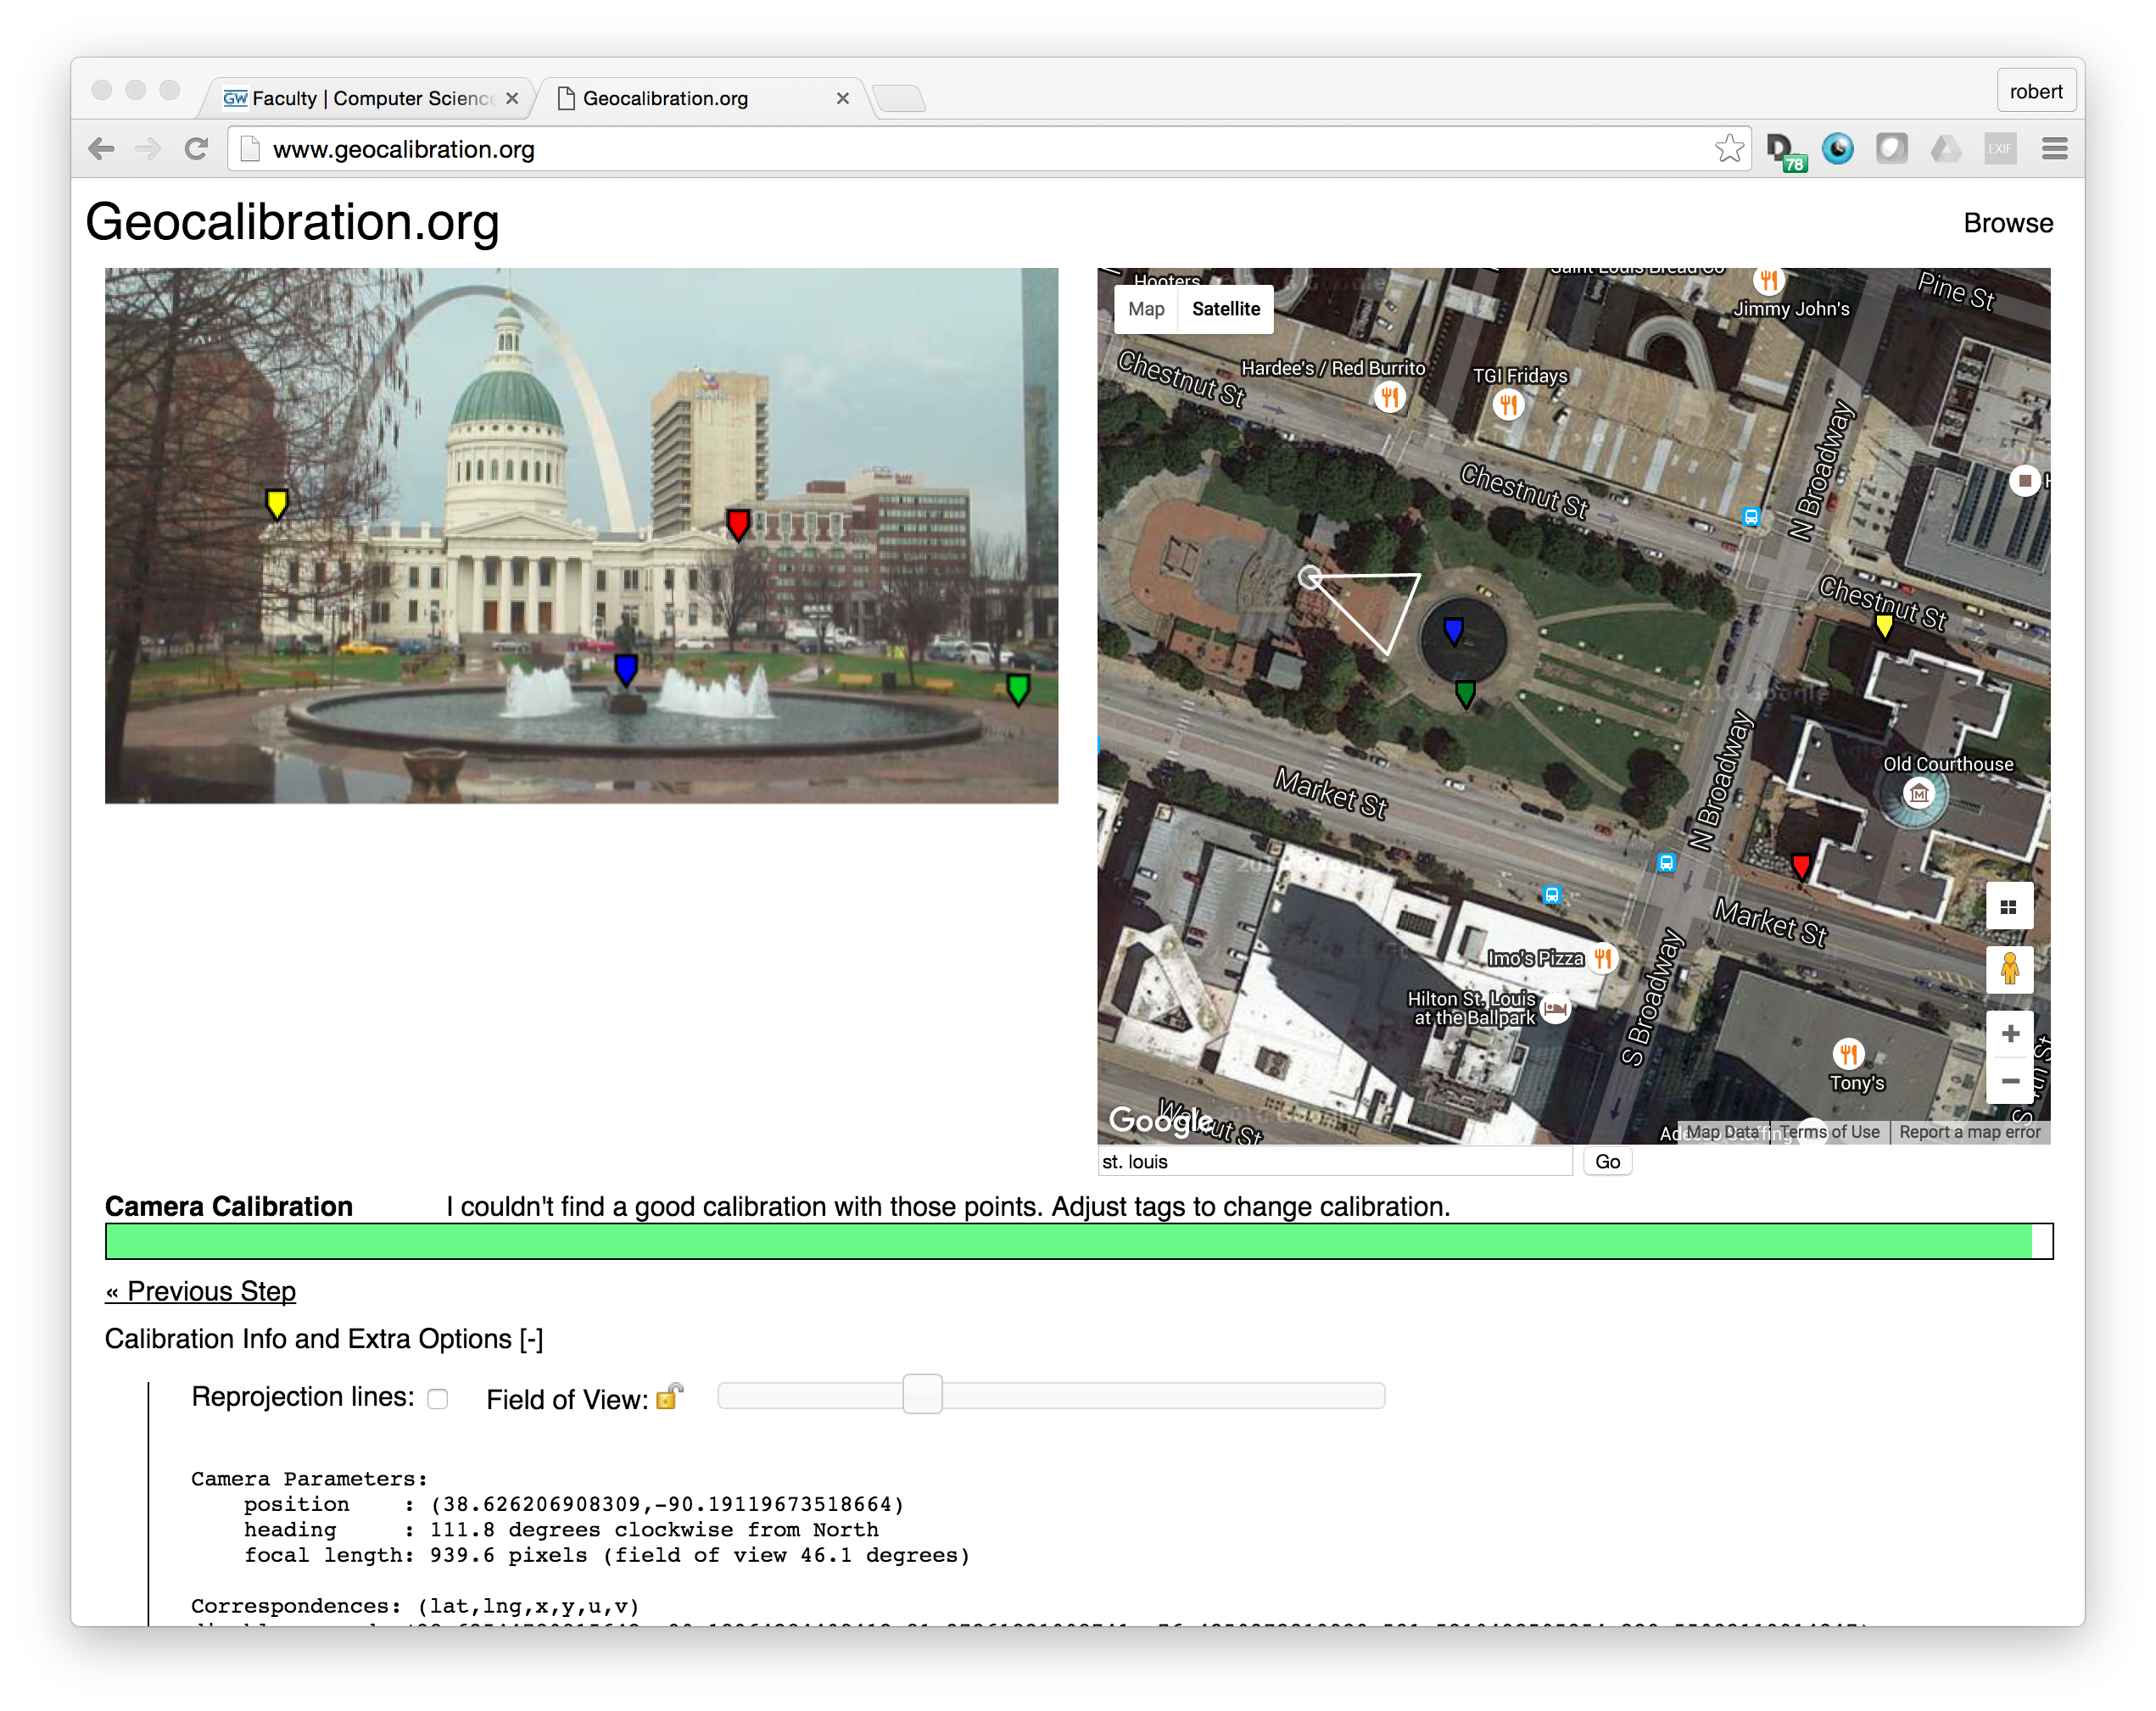
Notes:
Our mean point was within 8” of the mean point of the grave.

Slide 36
